Slide 1
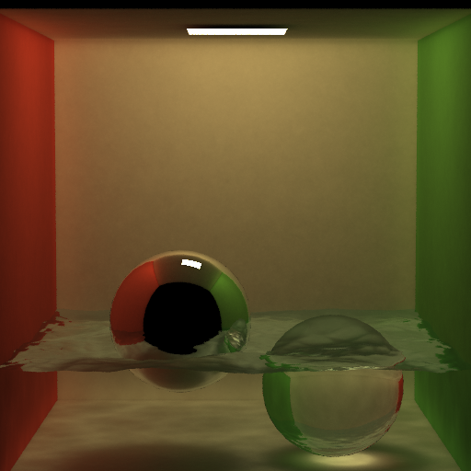
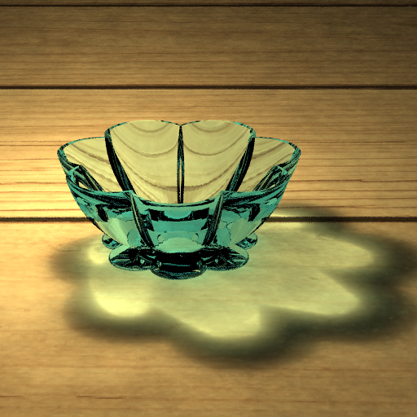
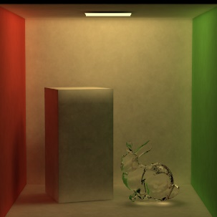
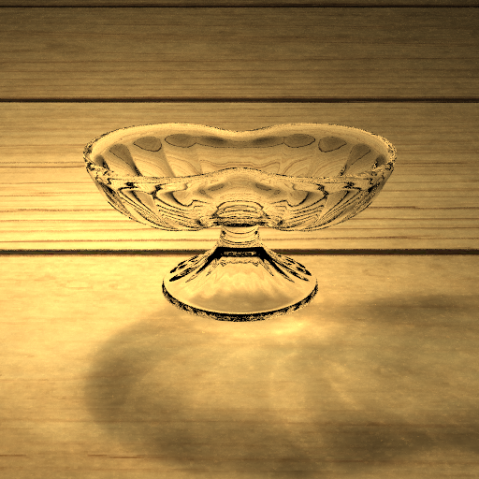
Final Project for CS171.01
Photon Mapping
Team 5:
毕春浩 杨宏笛 李慕天

Slide 2
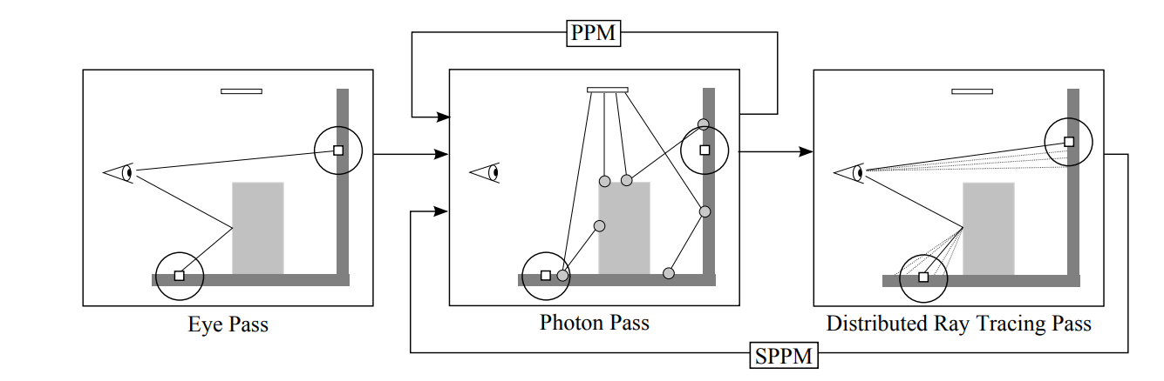
Introduction
In this project, we implement photon mapping based on SPPM (Stochastic Progressive Photon Mapping ) method.

Slide 3
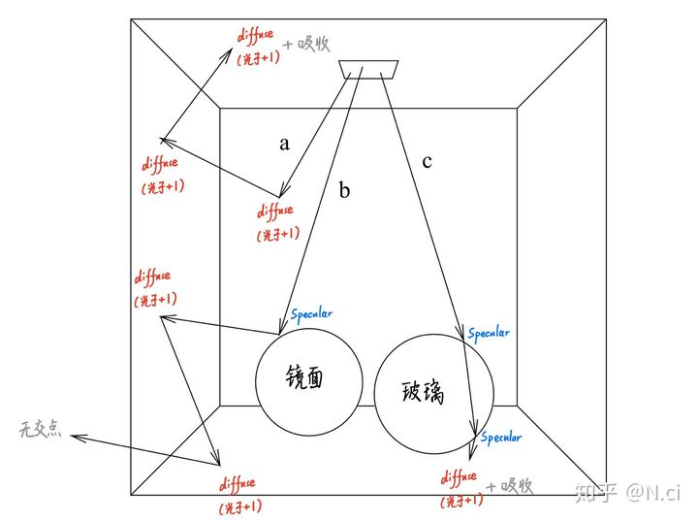
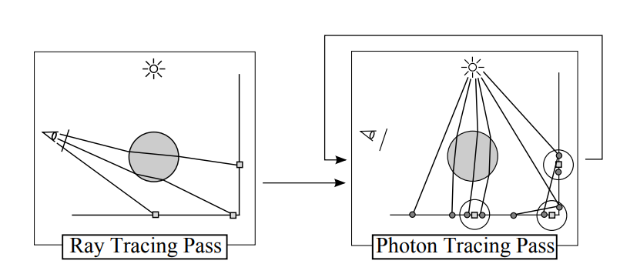
Photon mapping Methods
Photon mapping : Simple, but need to store a huge amount of photons.
Progressive Photon mapping : No need to store all photons now. However, to get a good result, we need high spp. Then we need to store a huge amount of viewpoints.
Stochastic Progressive Photon mapping : We can use rather low spp now to get a quit good result. So we do not need to store huge amount of either photons or view points.
PPM Pipeline

Slide 4
Rendering Pipeline
1. For each pixel, shoot Rays till they hit a diffuse surface, store the hit point as viewpoints.
2. Use the viewpoints we get from all pixels to construct a viewpoint balanced KD-tree.
3. Generate Photons from light sources, trace the photons using path tracing technique.
4. Update the pixel colors using temporary pixel energy accumulated in photon tracing part.
5. Update search radius 𝑟 = 𝑟 ∗ 𝛼, update photon energy coefficient 𝑒 = 𝑒 ∗ 𝛼.
6. Start next round.

Slide 5
Contribution
Member 1. Chunhao Bi : Ray tracing and Path tracing, Materials
and Texture, Algorithm Corrections.
Member 2. Hongdi Yang : Rendering pipeline, Light settings, Scene
construction.
Member 3. Mutian Li : Photon tracing, Color calculation

Slide 6
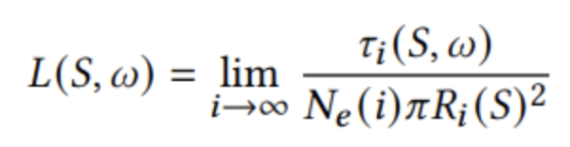
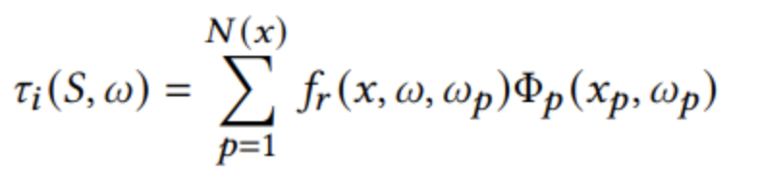
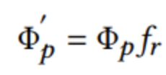
Formulas
For each photon, we trace its ray and update the pixels.
If the photon hits an ideal difussion surface, instead of storing the photon, we search the viewpoints within a radius around the photon, calculating the contribution, and updating the corresponding pixel.
Whenever the photon hits an object, we sample another ray according to the brdf and update the radiance, then continue photon tracing untill the maximum depth is reached.

Slide 7
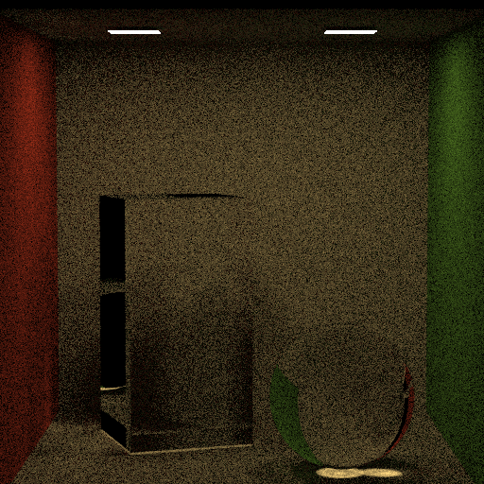
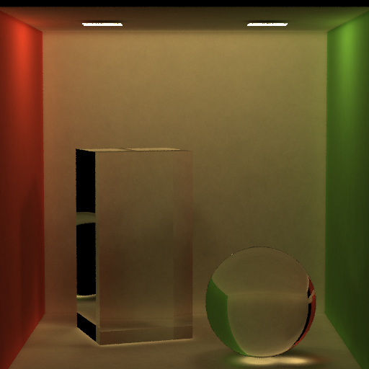
Compares
Why using photon mapping?
——Biased but Fast
Path tracing is unbiased but slow for small lights, because it is hard to hit the light.
Photon mapping is quick because lights search for you ( viewpoints ).
You can get a convincing result in a short time. ( but it is not totally true aka biased)
Path tracing
Photon mapping

Slide 8
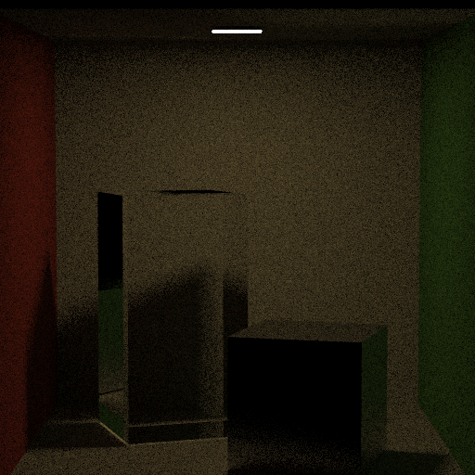
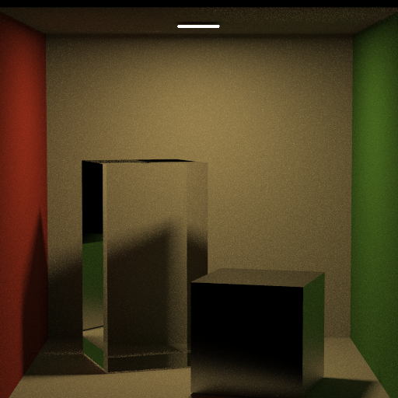
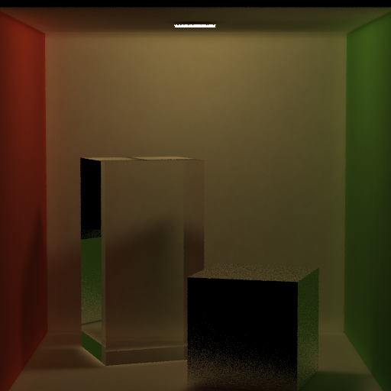
Compares
It is fast
All below were rendered in 550s.
Left is very dark, rays cannot hit lights
Middle is partially correct, the shadow makes direct lighting wrong because glass is considered as light-tight.
Right seems good (soft shadow), but glossy part (box) is not as good as direct lighting.
Monte-Carlo
Direct lighting
SPPM(photon mapping)

Slide 9
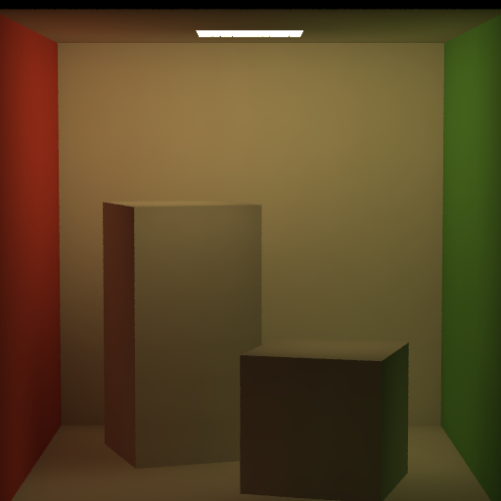
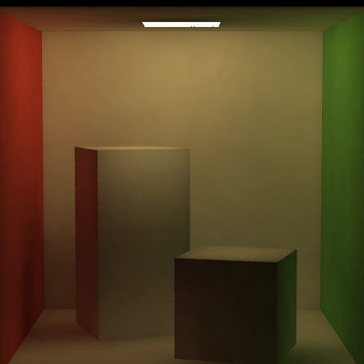
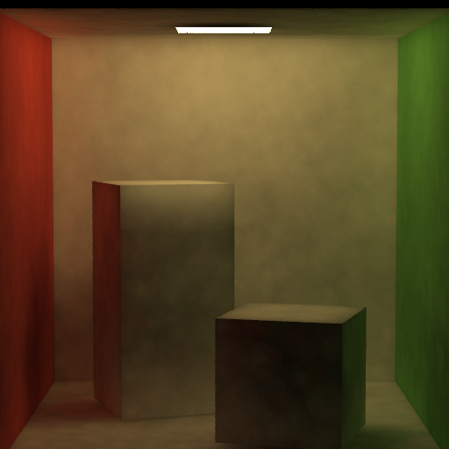
Compares
It is biased…
All below were using same parameters except initial r.
Left is very smooth but shadow is almost gone.
Right has a clear shadow but it is noisy.
This difference is because the estimator is biased, a smaller radius will reduce the bias but it will be more noisy, which can be solved by increasing photon number
Initial r = 1
Initial r = 0.5
Initial r = 0.125

Slide 10
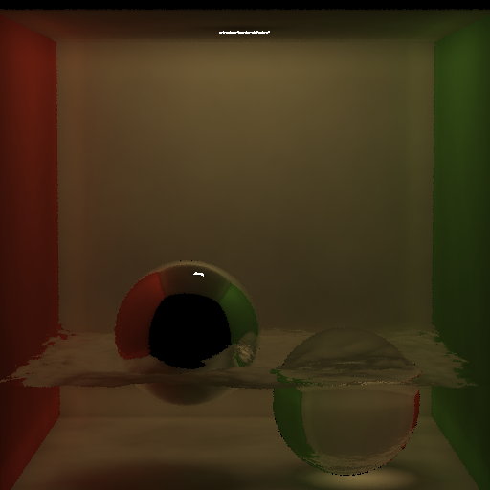
Experiments on Render Round
Render Round 0

Slide 11
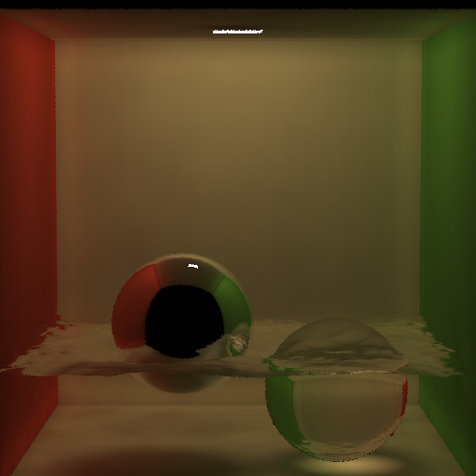
Experiments on Render Round
Render Round 1

Slide 12

Experiments on Render Round
Render Round 2

Slide 13
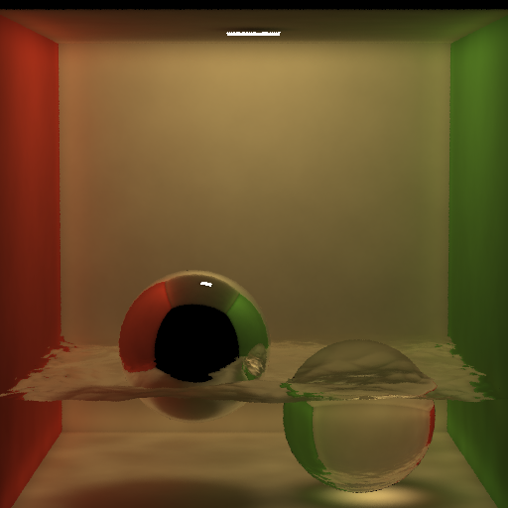
Experiments on Render Round
Render Round 3

Slide 14
Experiments on Render Round
Render Round 4

Slide 15

Experiments on Render Round
Render Round 5

Slide 16
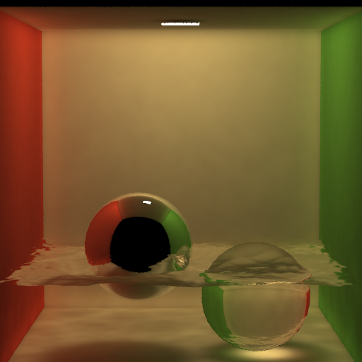
Experiments on Render Round
Render Round 6

Slide 17
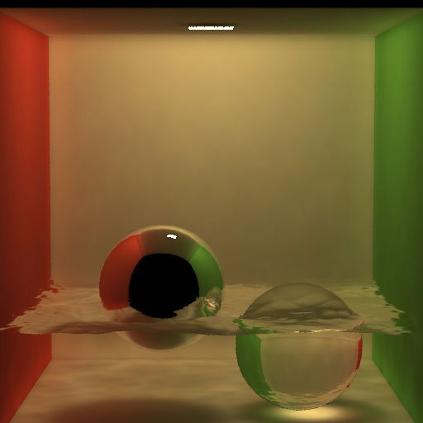
Experiments on Render Round
Render Round 7

Slide 18

Experiments on Render Round
Render Round 8

Slide 19

Experiments on Render Round
Render Round 9

Slide 20

Experiments on Render Round
Render Round 10

Slide 21

Experiments on Render Round
Render Round 11

Slide 22

Experiments on Render Round
Render Round 12

Slide 23

Experiments on Render Round
Render Round 13

Slide 24

Experiments on Render Round
Render Round 14

Slide 25

Experiments on Render Round
Render Round 15

Slide 26

Experiments on Render Round
Render Round 16

Slide 27

Experiments on Render Round
Render Round 17

Slide 28

Experiments on Render Round
Render Round 18

Slide 29

Experiments on Render Round
Render Round 19

Slide 30
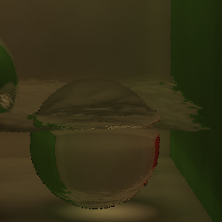
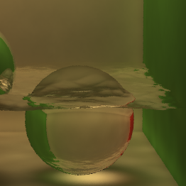
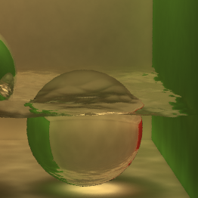
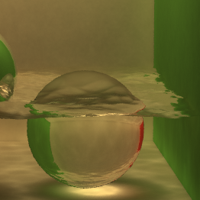

Experiments on Render Round
Caustics Effects
Round 0
Round 4
Round 9
Round 14
Round 19

Slide 31
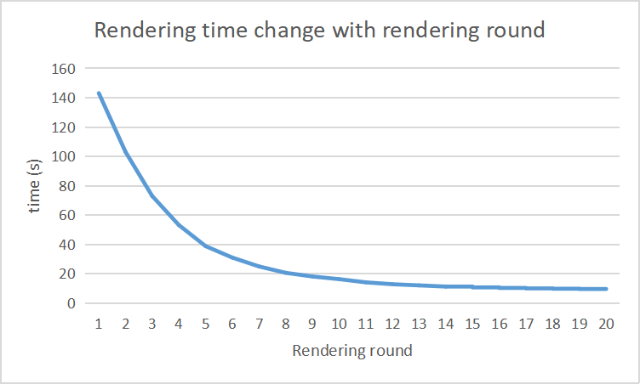
Experiments on Render Round
Rendering time

Slide 32
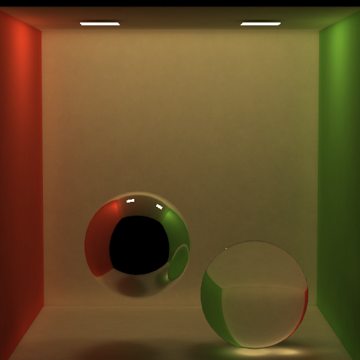
Results

Slide 33
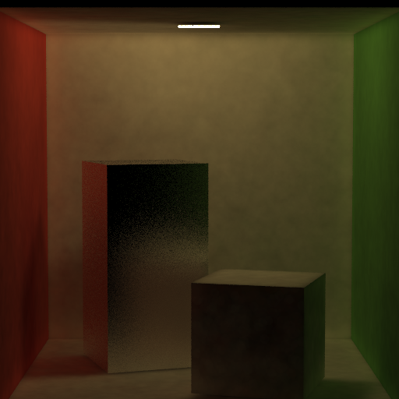
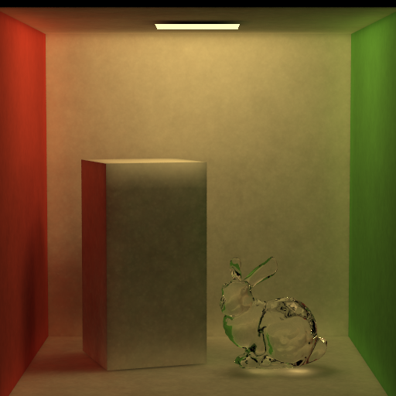
Results

Slide 34
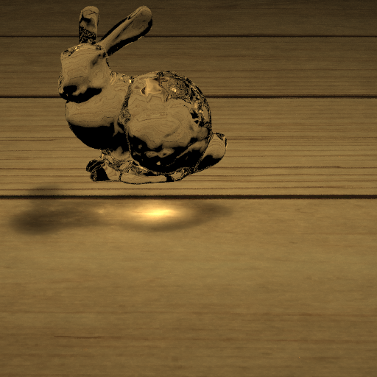
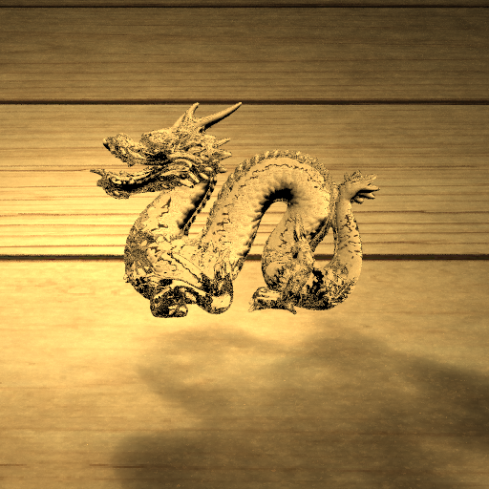
Results

Slide 35
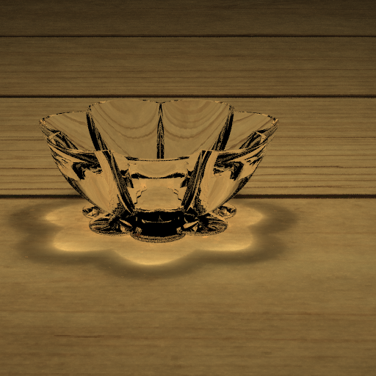
Results

Slide 36
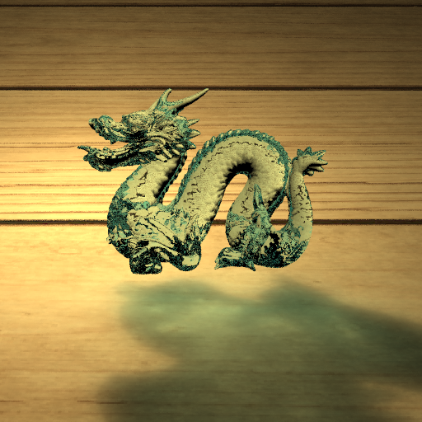
Results

Slide 37
Thanks for listening!

